Slide 1

Scan n’ Strategize
Team KAYAK

Slide 2
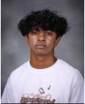
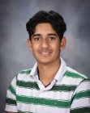
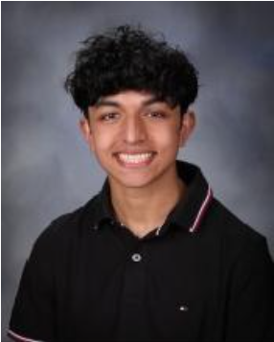
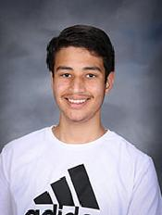
Meet the Team
Johan George
Kavish Verma
Karthik Arun
Yash Bansal
CSP
CSP
CSP
CSP
Notes:
Class name, period, teacher, year

Slide 3
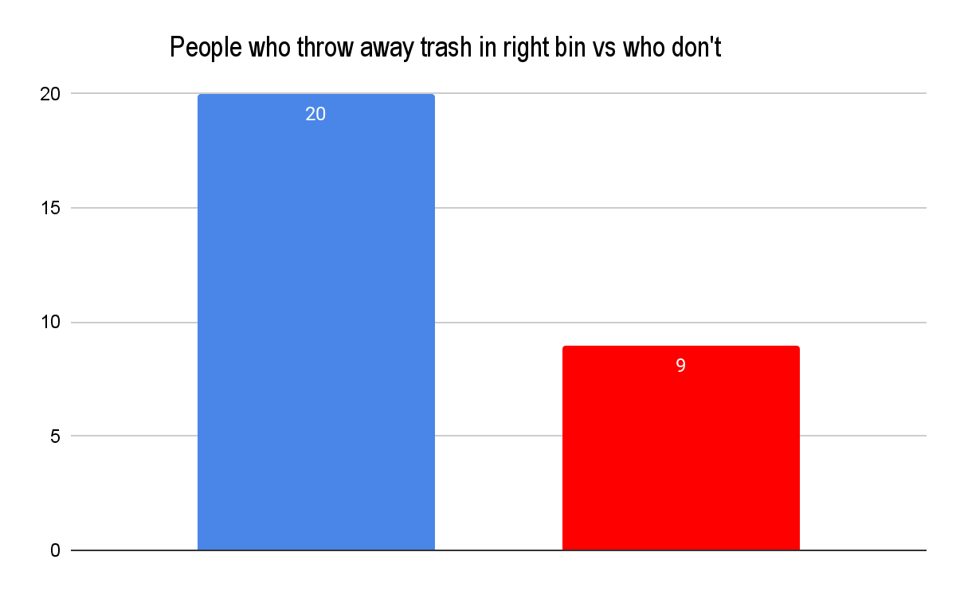
The Problem
People were taught a few rules of thumb: paper = recycle, plastic = trash, food = compost.
But today, there’s so many different types of products sold that we don’t immediately know where to dispose of them.
Instead, people mistakenly put them in the wrong place, resulting in numbers that you see on the right.
Our product can be of use to anyone who deals with disposing of things … which is everybody!
Fun fact: Nearly a FIFTH of recyclable items are placed in the wrong bin and go to landfill, study reveals (Daily Mail)
Notes:
Talk about targeted consumers with numerical data on how many people this will affect

Slide 4
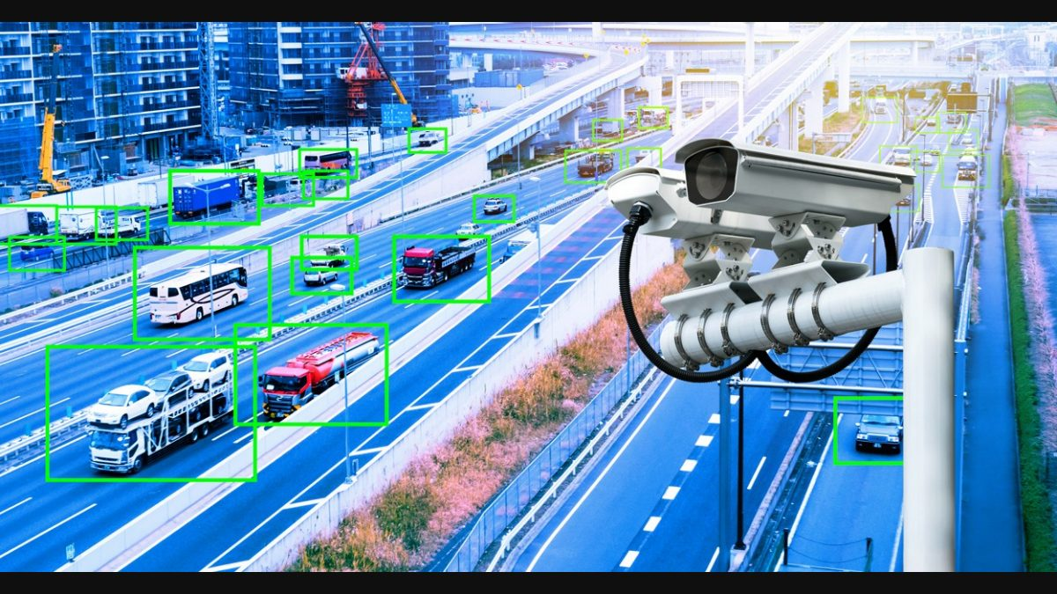
The Solution
Add trackers to the trash so you know what is recyclable and what goes in the garbage
We believe that artificial intelligence and machine learning offer an effective way to address this problem. Our proposed solution offers an unprecedented way of guiding the user on the appropriate bin for disposal.
It utilizes the user's camera to detect various types of trash as shown in the picture to the left, except with cars.
By integrating advanced image recognition technologies, we can streamline the sorting process, making it easier for users to correctly separate recyclables, compostables, and waste, thereby promoting better environmental practices.
Have high quality cameras so it knows what trash is being picked up and also the AI intelligence is at its highest.
Notes:
Talk about the solution and how it helps. Highlight key features of the solution

Slide 5
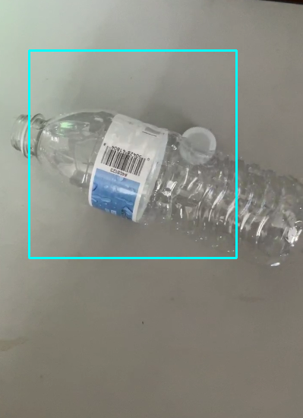
How does it work?
Our solution uses haar cascade, a popular type of image detection, in order to detect garbage.
This module is used with OpenCV, NumPy, and Pandas, all of which improve the efficiency of the data processing.
First, we tell the compiler what .xml file to read the data from(which we pre-train in CascadeTrainerGUI), then we tell it to use the user’s camera in order to detect the trash.
Notes:
Talk about the solution and how it helps. Highlight key features of the solution

Slide 6

What we could add
As of right now, out application is still not a full fledged program, with many more features that need to be added. These include:
A way to tell which bin the trash goes in, which has proved to be difficult, considering the time it takes to train data
Better GUI in order to better the user experience(more accurate)
A way to add the application onto phones, into App Store for IOS and Android users
Storing user data on cloud
Notes:
Talk about the solution and how it helps. Highlight key features of the solution

Slide 7
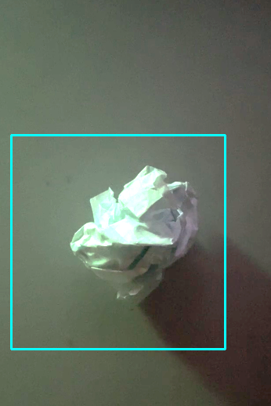
Funding
Our product is the first of its kind
It has a simple yet widely-applicable algorithm that can scan trash items of all widely-used sizes
Can be sold in virtually every home
We need the funding for
Designing a method to make this a mobile app
Creating a better GUI
Obtaining user data and storing it on cloud
This will increase our program’s response time
Notes:
Talk about the solution and how it helps. Highlight key features of the solution

Slide 8
Works Cited
Jackson, F. (n.d.). Nearly a FIFTH of recyclable items are placed in the wrong bin and go to landfill, study reveals. Mail Online. Retrieved May 10, 2024, from https://www.dailymail.co.uk/sciencetech/article-11339593/Nearly-FIFTH-recyclable-items-placed-wrong-bin-landfill-study-reveals.html
OpenCV: Cascade Classifier. (n.d.). Docs.opencv.org. Retrieved May 10, 2024, from https://www.google.com/url?q=https://docs.opencv.org/3.4/db/d28/tutorial_cascade_classifier.html&sa=D&source=editors&ust=1715664317864794&usg=AOvVaw3KyPPFT09NhinhThPMlrx4
opencv/opencv. (n.d.). GitHub. https://github.com/opencv/opencv/tree/master/data/haarcascades
Rio, B. (2022, December 4). benjamrio/sort-it. GitHub. https://github.com/benjamrio/sort-it

